Slide 1
Presented by Joshua Kabwanga
28 Jan 2023
Local retails insight
Data analyst report

Slide 2
Objective from the stakeholder
The purpose of this project a dataset has been provide from the stakeholders to reveal compelling insights. That encourages the approach with creativity, analytical rigor, and attention to detail. that will be considered as an opportunity to showcase my data analysis skills and demonstrate how I can contribute to driving insights within the organization.
Dataset Description
The provided dataset offers a detailed snapshot of transactional activities across major grocery retailers. It encompasses crucial information including transaction IDs, customer IDs, merchant details, transaction descriptions, dates, and transaction amounts.

Slide 3
Data cleaning and Transformation
I used Ms. Excel to clean and manipulate the dataset and tableau dashboard for visualization purpose, the dataset contains 69711 rows with 5 columns.
There was no duplicate and missing data found in the dataset.
For the purpose of this analysis, I added:
1. Monthly column which was extracted from the transaction Date.
2. Merchant column I was able to separate the three main merchant brand name into a columns:
Checkers Sixty60, Pick n Pay asap, Pick n Pay online, Woolworths Dash, Woolworths online.

Slide 4
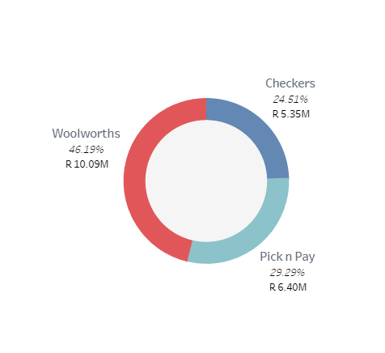
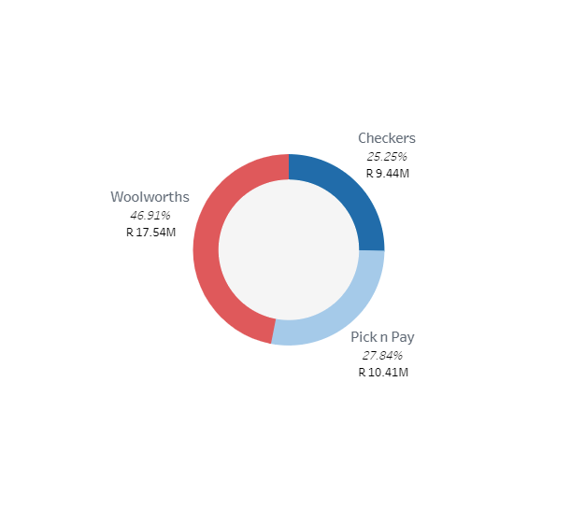

Key Insight
The dataset provided is over the period of 18 months, which started from January 2020 to Jun 2021, during the period mentioned the are 889 customers, 69 710 total number of transactions recorder in the dataset with R37 401 319 revenue from 3 different merchant as indicated in pie chart.
The most profitable merchant is Woolworths with 46.19% of the sales follow by Pick n pay with 29.29% compared to checkers which is the less with 24.51% of revenue. That gives the different between Woolworths and Checkers of 21.68%.

Slide 5
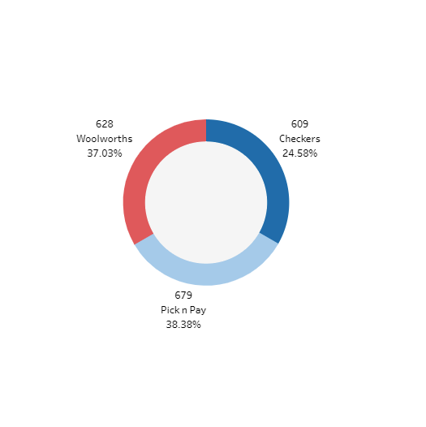
Customer distribution
Customer distribution over the period of 18 months. during the period mentioned the are Distinct 889 customers recorded in the dataset, Pick n Pay has 679(38%) follow by woolworths 628(37%) recorder, and Checkers dataset with R37 401 319 revenue from 3 different merchant.

Slide 6
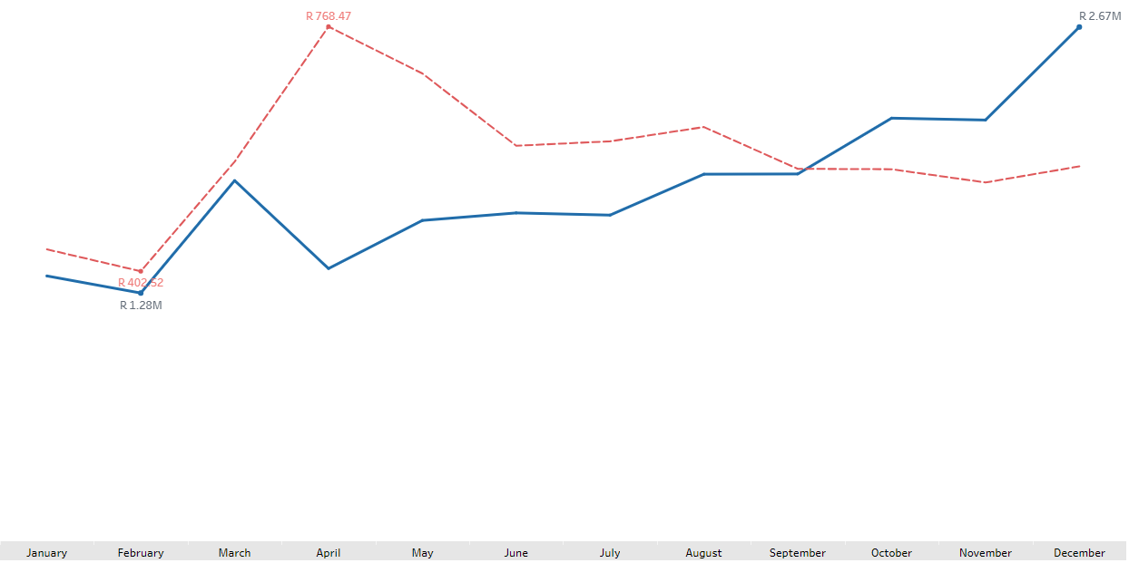

2020 Key performance vs monthly sale
The above line chart indicate December as the best month sale R2.67M in revenue compared to other months.
Average sales per month show April is the best month with R768.47
December is also known as a month when people receive bonuses when most companies close for the Christmas and New Year holidays and people spend money to celebrate.

Slide 7
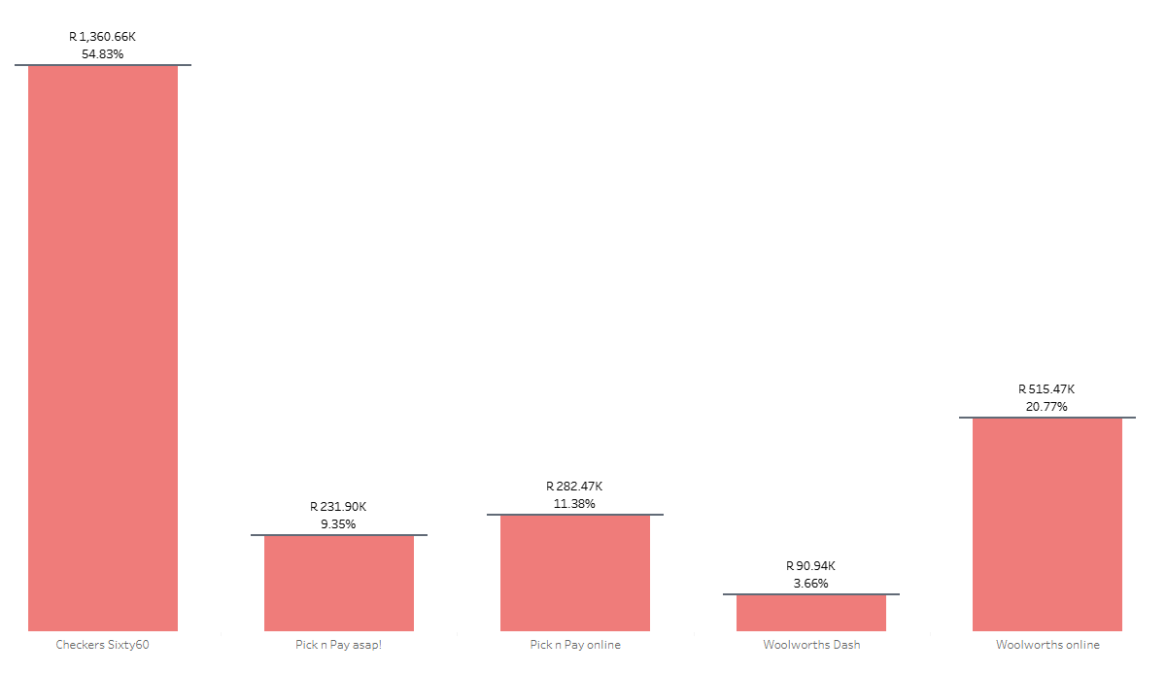
Total sale per sub merchant
Sub-merchant key performance
Checkers sixty60 is on the lead in marketing with 54.83% revenue alone followed by Woolworths online with 20.77%, then Pick n Pay online with 11.38%. The less profitable is Woolworths Dash with 3.66%

Slide 8
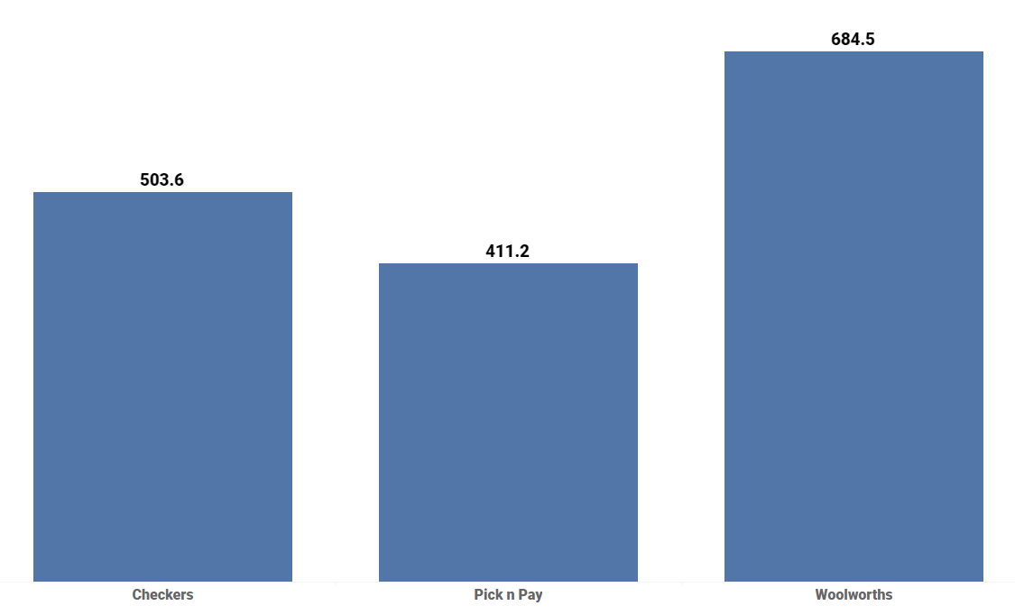
Average amount per Merchant
The term “Average” describes a value that should represent the sample.
An average is defined as the sum of all the values divided by the total number of values in a given set. It is also known as the arithmetic mean.
After the above calculation woolworths has the highest amount average follow by Checkers then Pick n Pay.
With this we should now understand why woolworth has the most profit compare with the rest merchant.

Slide 9
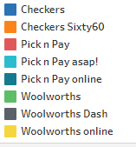
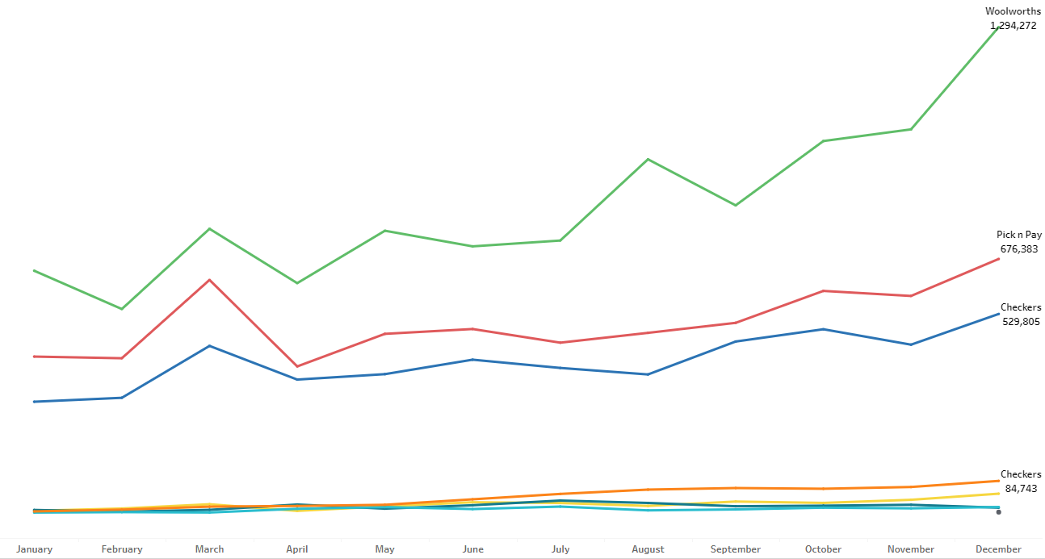
Key Performance per month

Slide 10
Conclusion
Between the period of 18-month Woolworths is the most profitable brand with 46.91% revenue compared to Pick n Pay 29.29% and Checkers 27.27%.
Customer distribution indicated that Pick n Pay has 38.38% customers compare follow by Woolworth 37.03%, but the average price showed the Woolworth products are high then pick n pay. This is the reason why Woolworth Brand is the leading market in revenue.
December is the most profitable month then other months.
According to the observation, the period of 18 months that the dataset was recorded which is from January 2020 to June 202, the 2021 seems to be the most profitable year compared to 2020. The reason being if calculate 2020 from January to June month the period of 6 month we have 9.30Millions (37%), compare 2021 from January to June the period of 6 months we have 15.57Millions(63%) which gives the different of 26% margin.

Slide 11
Thank you…

